Slide 1
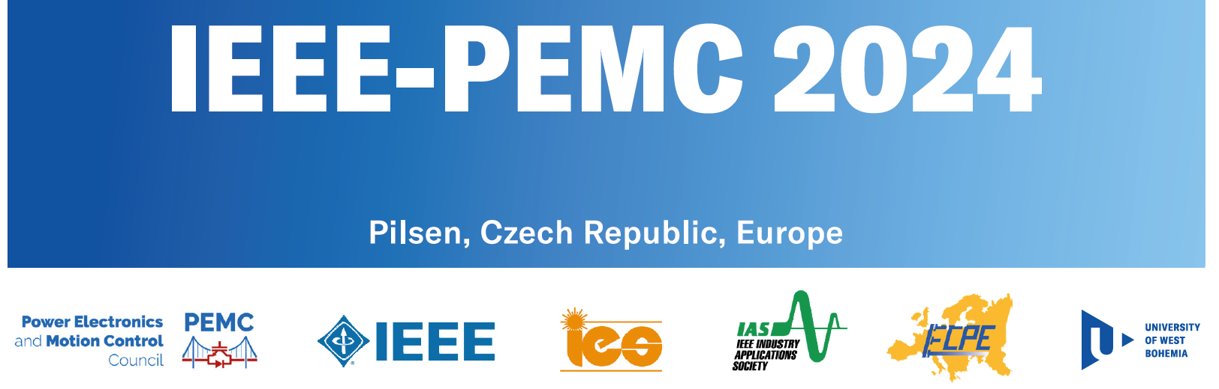
Modular Digital twin platform for Electrical Drivetrains
Linked Projects
Speakers:
Omar Hegazy, MOBI-EPOWERS Research Group, Vrije Universiteit Brussel (VUB), Brussels, Belgium
Mohamed El Baghdadi, MOBI-EPOWERS Research Group, Vrije Universiteit Brussel (VUB), Brussels, Belgium
Sajib Chakraborty, MOBI-EPOWERS Research Group, Vrije Universiteit Brussel (VUB), Brussels, Belgium

Slide 2
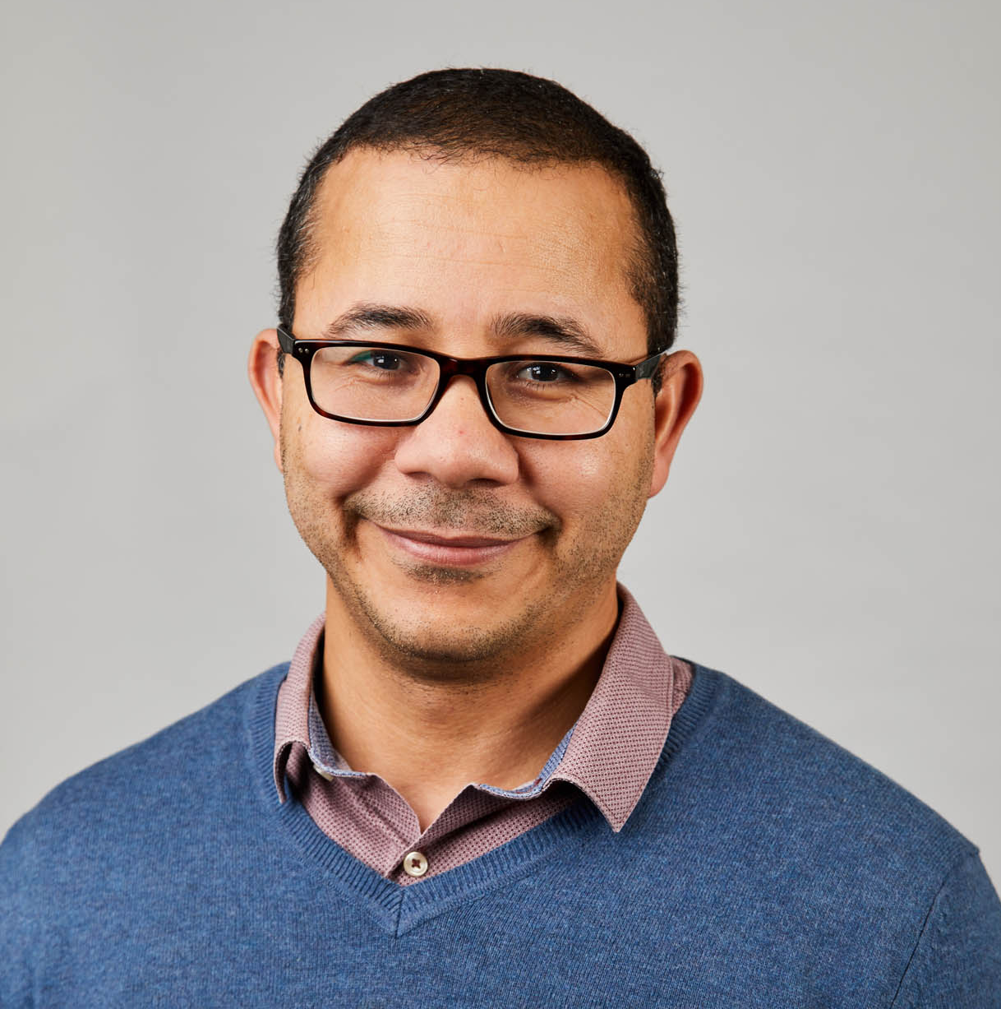
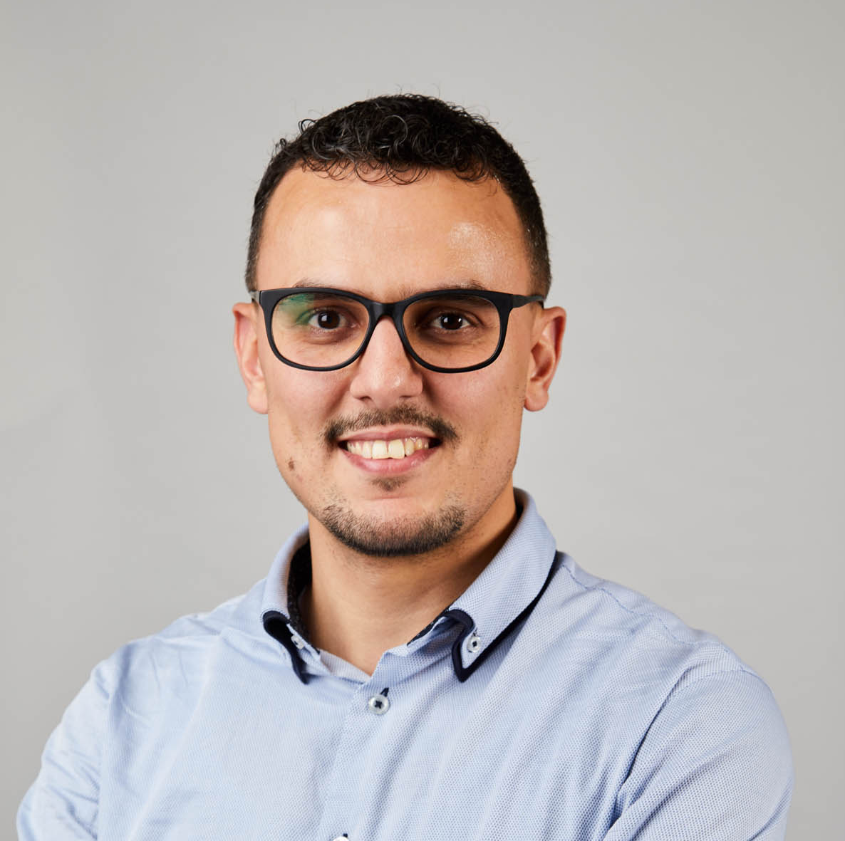
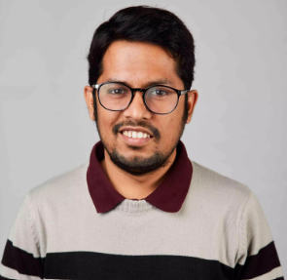
Lecturers' information
Prof. Dr. Mohamed El-Baghdadi
Dr. Sajib Chakraborty
Prof. Dr. Omar Hegazy
Omar.Hegazy@vub.be Head of EPOWERS
Mohamed.el.Baghdadi@vub.be Leader of Vehicle Technology and
Connectivity (VTC) Team
Sajib.Chakraborty@vub.be Leader of Digital Twin and Reliability (DTR) Team

Slide 3
ELECTROMOBILITY RESEARCH HUB IN EUROPE

Slide 4
15+
40+
EU funded projects
Members
Top-Notch Labs
Research Tracks
Brussels, Belgium

Slide 5
Short Introduction of MOBI-EPOWERS
EPOWERS research group Efficient Power Electronics, Powertrain & Energy Solutions​
Power Electronics
Charging Systems
Inverters & multi-level converters
DC/DC converters & Active Front-End (AFE)
Battery Management Systems
Vehicle Powertrains
Powertrain Co-design optimization
Integrated EMS for Plug-in/Hybrid/Electric Vehicles
Multi-level and ECO-EMS strategies
Electrical Machines
Design and Optimization
System Control
Performance Assessment
Digital Twin & Reliability
Technology and Prototype Validation in Relevant Environment
Fully Proofed Technology, Operational System and Manufacturing
Smart Green Grid Solutions
Design Optimization
(Control) Energy Management

Slide 6
Tutorial Content
Introduction to Digital Twin Platform for EVs [Presenter: Omar Hegazy]
Introduction to E-drivetrain Architecture and Digital twin for EVs
Requirements and Challenges for Implementing Digital Twins in Automotives
Future Developments and Emerging Trends in Digital Twin Technology
Part I: Digital Twin: Performance and Efficiency [Presenter: Mohamed El Baghdadi]
Virtual Models for design
Virtual Models for Control and Management strategy
Virtual Models Parameterization and Calibration
Virtual Models transition towards Digital Twin Concept
Part II: Digital Twin: Lifetime and Safety [Presenter: Sajib Chakraborty]
Digital Twin Context for Lifetime and Safety
Model-based Reliability Estimation
Online Prognostics and Health Management (PHM)
Conclusions and Future Outlooks [Presenter: Omar Hegazy]

